Slide 1


Outsourced Cloud Deployment
Trusted Proxy
Queries
Queries
DB
Client
Untrusted Cloud
Data owner wishes to deploy their order fulfillment business in the cloud. They do not wish to disclose their private data to the service provider including customer identities and their orders.

Slide 2


Mutually Distrustful Data Owners Setup
DO
DO
Queries
Queries
Clients 1
Warehouse 1
Warehouse 3
Clients 3
DO
DO
Queries
Queries
Clients 2
Warehouse 2
Warehouse 4
Clients 4
A group of businesses wish to collaborate to help one another fill orders from their inventories.
Distributed orders use MPC to protect the privacy of customer data and their orders

Slide 3
Problem Definition
How to update oblivious indexes? ObliDB might have ideas for this.
Locking has ~2 cases:
Simple case: tuple-at-a-time locking; only works when our transactions do point lookups alone. Only reveals information if there is contention over a row
For queries that access tuples by some predicate, need to do page or table-level locking. Since the templates are known a priori, if their constants won’t inform our locking choices, this is ok too.
Locking is hard - has many more side channels.
Need to decide what isolation level we want to support; this varies a lot in practice. Simplest case, serializability. Still complicated under concurrency.

Slide 4
Strawman Solution
If we use optimistic concurrency control, the client tries a transaction once and if it fails they retry. Transactions arrive in a continuous stream from clients.
Subsequent queries are indistinguishable from one another in their constants. The transaction’s template is known by all a priori.
Client keeps throughput secret. We use regular “heartbeats” to sync clients with their abort / commit state, and the reverse for submitting xctions
When a transaction fails, we displace the next instance of this template to not disrupt the usual distribution of transaction types
When a transaction fails, we insert dummy tuples for the inserts it would have done if it committed s.t. the server cannot deduce its outcome
What about running one at a time?

Slide 5
Should we use the same evaluation metrics to evaluate protocols on TPC-C? No
We need rigorous analysis of existing systems and determine what metrics to evaluate them on:
Functionality supported: support for different types of queries (public transactions, differentially private transactions, completely oblivious)
Quantifying security: Obliviousness, timing channels, differential privacy: what does this even mean?
Assume a distribution of queries for overlap? Pad latency?
Amount of trust: Is FHE the best baseline (in the single user outsourcing scenario?) Is MPC the best baseline?
Single user database vs multiple users contributing data? Even for multiple users, we have a small set of multiple companies vs multiple small users.
Do we have adversarial clients? JR: I think we have to trust the clients to make this work. Perhaps liken this to OPRAM, where clients are considered on the same team b/c we are just parallelizing. KN: what can we do in the presence of adversarial clients? In the presence of locks?

Slide 6
Questions
Hybrid transaction-analytic processing. OLAP queries? Separate databases? Streaming accesses?
How can we do oblivious concurrency control for simplest setting of reads and writes?
Can we have OPRAM to improve performance (depth of the computation)?
Is logging and recovery straightforward? Replay log? What metrics can be optimized?
Can we obtain fairness/censorship resistance?
Can we have adversarial clients?

Slide 7
Trusted Proxy
Execution performed by trusted proxy (it stores versions/conflicts and easily solve write-conflicts)
Problems: large amount of trust, bad commit latency
Trusted proxy as multiple non-colluding entities.
How do we solve write-conflicts?
What does #retries reveal?
How does one roll-back?
If we use locks, what does not obtaining a lock imply?
What is the minimal trust assumption that we need?
How are gateways/client terminals related to us?

Slide 8
Bounding the Problem Definition
Optimistic concurrency control has fewer side channels than lock-based solutions.
Server / cloud provider is always untrusted.
Clients are trusted (at least for now)
Need to clearly define isolation level we wish to offer - congruent with our security guarantees. These two factors are dependent on one another.
Have a few cloud provider servers (~single digit) - as opposed to blockchain with 100s of computing nodes.

Slide 9
Milestones - all settings are concurrent
Different problem settings:
(Write once??) Query answering - view selection, secure index design - read only?
Existing work: matrix mechanism (https://people.cs.umass.edu/~mcgregor/papers/15-vldbj.pdf), HDMM (http://www.vldb.org/pvldb/vol11/p1206-mckenna.pdf)
Correct answers vs DP answers
Append-only writes - incremental updates with DP query answering, and fast point lookups with public writes, single DB, public write/secret read ORAM?
Correct answers vs DP answers
Arbitrary writes
Correct vs DP answers
One client - oblivious transactions - has concurrency
Multiple, independent clients - transactions with ACID
Correct answers (maybe use DP to speed them up)
Concurrency protocols
Recovery

Slide 10
Research Thrust I: Secure SQL Execution over a Static Database
Multiple concurrent queries by a single client
Multiple concurrent queries by multiple clients, some of whom can be malicious
Multi-query optimization from an MPC/ORAM perspective (amortization)
Multi-query optimization from a DP perspective (amortization)
Secure index/view selection (not sure what it is for now)
Research Thrust II: Secure SQL Execution over a Dynamic Database
Append only
Insert and update
Research Thrust III: Supporting Queries with Concurrency and ACID
Research Thrust IV: Supporting Queries with Multiple Clients

Slide 12
Background: TPC-C Overview
& Security Model

Slide 13
TPC-C Overview
Goal: provide a lens for the discussion of practical privacy models and security guarantees for oblivious transactions
TPC-C walkthrough: [slides]
OLTP-bench for implementation details [pdf] [code]
Transactional workloads are write-intensive and must handle conflicts, e.g., when 2+ clients simultaneously wish to mutate the same data
TPC-C based on example business, takes new orders, maintains inventory in warehouses, accepts payments, etc.

Slide 14
TPC-C Transactions
Measuring transactions / minute (tpmC)
Mix of 5 transactions: new order (45%), payment (43%), order-status (4%), delivery (4%), stock-level (4%)
Must uphold ACID properties
Scale up data size and concurrency by adding warehouses
Increase concurrency by adding warehouses
Each warehouse has 10 terminals or clients, each terminal has a maximum of 1.2 tpmC
Transactions have stringent response time requirements: 90% <= 5 secs for all, except OLAP-ish stock-level ones @ 20 secs

Slide 15
TPC-C Data Layout
Schema has 9 tables
Typically partition DBMS by warehouse
Asymptotically this results in ~11% of xactions being distributed
Partition-by-warehouse can be used to approximate having multiple businesses work together in the federated setting

Slide 16
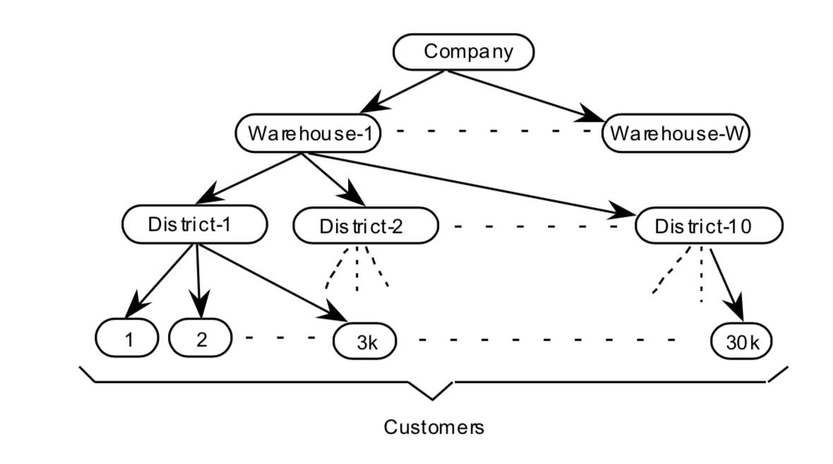
TPC-C Data Hierarchy
# of warehouses proportional to
xaction submit rate
Each warehouse has 10 sales
districts / clients
Each district has 30k
customers / buyers in DBMS

Slide 17
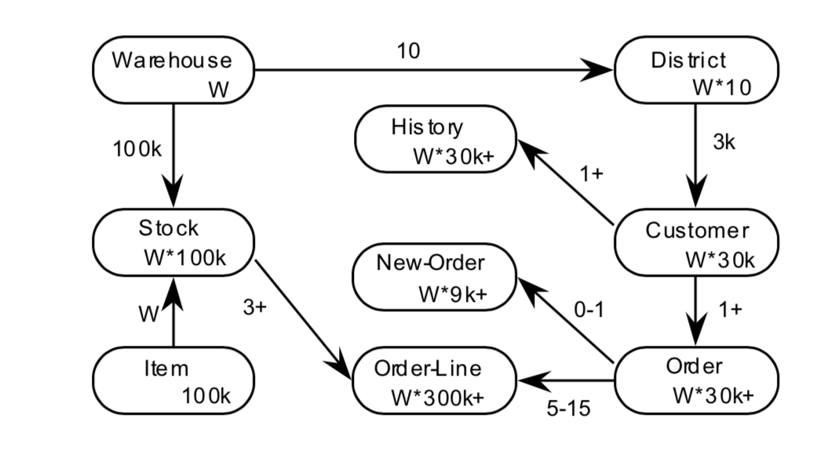
TPC-C Schema
likely needs to be secured
for distributed xactions

Slide 18
Background: Locking Granularities

Slide 19
Handling DB Updates
If we relax the assumption that the DB is a fixed collection of objects, even locking will not assure serializability:
T1 locks all pages containing sailor records with rating = 1, and finds oldest sailor (say, age = 71).
Next, T2 inserts a new sailor; rating = 1, age = 96.
T2 also deletes oldest sailor with rating = 2 (and, say, age = 80), and commits.
T1 now locks all pages containing sailor records with rating = 2, and finds oldest (say, age = 63).
No consistent DB state where T1 is “correct”!
SELECT rating, MAX(age)
FROM sailors
GROUP BY rating;
Notes:
T2 = new pages not known at T1 start, thus not locked.

Slide 20
Phantom Problem
T1 implicitly assumes that it has locked the set of all sailor records with rating = 1.
Assumption only holds if no sailor records are added while T1 is executing!
Need some mechanism to enforce this assumption. (Index locking and predicate locking.)
Example shows that conflict serializability guarantees serializability only if the set of objects is fixed!
Notes:
Phantom problem example – Say SELECT max(age) FROM sailors WHERE rating > 5; - get to lock point, then someone adds a sailor with rating 6 and a new highest age. First query now returns the wrong answer.

Slide 21
Multiple-Granularity Locks
Hard to decide what granularity to lock (tuples vs. pages vs. tables).
Shouldn’t have to decide!
Data “containers” are nested:
Database
contains
Tables
Pages
Tuples

Slide 22
Locking Granularity
So far, we've mostly used an abstract model of "objects" being read, written, and locked
e.g. RX WX
It hasn’t been clear what "X" is here
In practice, X could be a tuple, page, table, or whole database
What’s the trade-off?

Slide 23
Locking Granularity (cont’d)
Finer granularity offers better control of what is NOT locked
Better concurrency for queries that touch few tuples
Locking a whole table for looking a single username makes no sense
Coarser granularity requires fewer locks to control a large collection of tuples
Locking each tuple involved in computing an average aggregation will take forever
Coexistence of locks at different granularity?

Slide 24
Locking Hierarchy
Intention Locks in a Locking Hierarchy
Intention locks indicate that a transaction is going to read / write some part of a table
A transaction holds an intention lock on higher levels to indicate intention to read/write at a lower level
Example
To lock a tuple X in page P in Table T in X mode, First need to hold Intention X (IX) locks on P and T.
Lock order: IX(Table X); IX(Page X); X(Record X)
Release in opposite order
Tuples
Pages
Tables

Slide 25
Locking Hierarchy
IX/IS – Intention S – locks prevent people locking just the upper levels of the hierarchy from conflicting with transactions locking lower levels of the hierarchy
Lock compatibility
 | S | X | IX | IS
S | Y | N | N | Y
X | N | N | N | N
IX | N | N | Y | Y
IS | Y | N | Y | Y

Slide 26
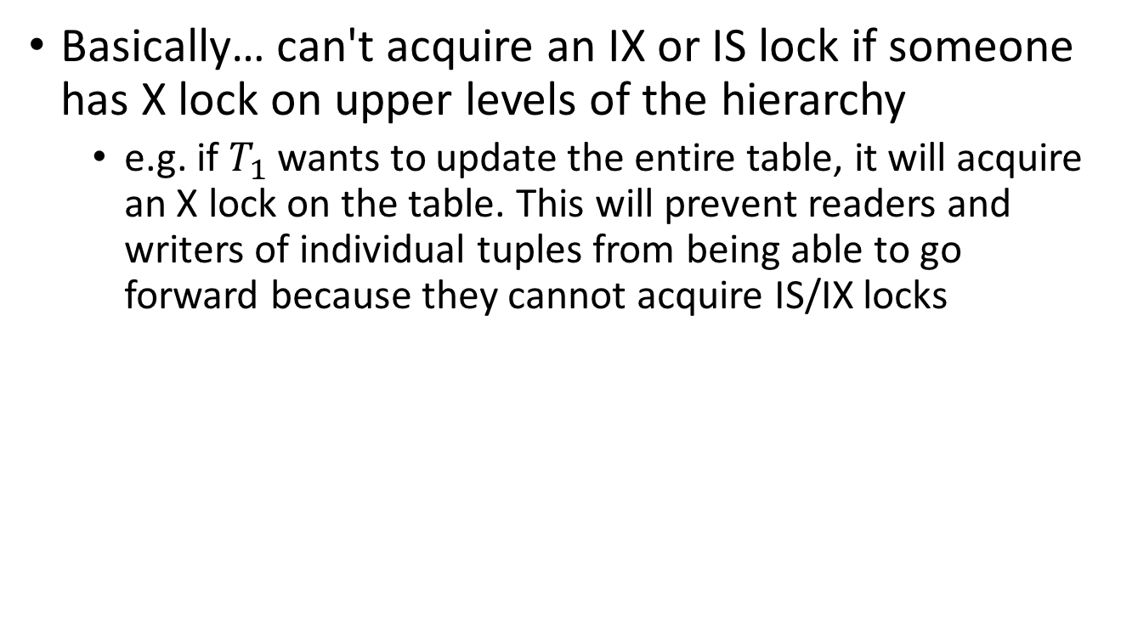
Locking Hierarchy
 | S | X | IX | IS
S | Y | N | N | Y
X | N | N | N | N
IX | N | N | Y | Y
IS | Y | N | Y | Y

Slide 27
Preventing Phantom Reads
Review: Phantom Read
A transaction reading the same set of tuples twice, a newly inserted record may appear in the second read
Solution
Add some form of logical lock using predicates
e.g. IS or IX lock a logical subset of the database

Slide 28
Solution: New Lock Modes, Protocol
Allow Xacts to lock at each level, but with a special protocol using new “intention” locks:
Before locking an item, Xact must set “intention locks” on all its ancestors.
For unlock, go from specific to general (i.e., bottom-up).
SIX mode: Like S & IX at the same time.
--
IS
IX
S
X
--
√
√
√
√
√
IS
√
√
√
√
IX
√
√
√
S
√
√
√
X
√

Slide 29
Multiple Granularity Lock Protocol
Each Xact starts from the root of the hierarchy.
To get S or IS lock on a node, must hold IS or IX on parent node.
What if Xact holds SIX on parent? S on parent?
To get X or IX or SIX on a node, must hold IX or SIX on parent node.
Must release locks in bottom-up order.
Protocol is correct in that it is equivalent to directly setting
locks at the leaf levels of the hierarchy.

Slide 30
Examples
T1 scans R, and updates a few tuples:
T1 gets an SIX lock on R, then repeatedly gets an S lock on tuples of R, and occasionally upgrades to X on the tuples.
T2 uses an index to read only part of R:
T2 gets an IS lock on R, and repeatedly gets an S lock on tuples of R.
T3 reads all of R:
T3 gets an S lock on R.
OR, T3 could behave like T2; can use lock escalation to decide which.
--
IS
IX
S
X
--
√
√
√
√
√
IS
√
√
√
√
IX
√
√
√
S
√
√
√
X
√

Slide 31
Predicate Locking
Grant lock on all records that satisfy some logical predicate, e.g. age > 2*salary.
Index locking is a special case of predicate locking for which an index supports efficient implementation of the predicate lock.
What is the predicate in the sailor example?
In general, predicate locking has a lot of overhead.

